Slide 1
BUSINESS INTELLIGENCE
TEMU

Slide 2

TEMU
Temu, a Boston-based online marketplace operated by PDD Holdings, gained rapid popularity since its U.S. launch in September 2022, offering heavily discounted goods directly from China.
Expanding globally, Temu entered Canada, Australia, Europe, and Latin America, leveraging a unique business model focused on direct sales, strategic affordability, and user incentives.

Slide 3
Guiding Principle
Data Analysis
Data Analysis, pattern identification and trend exploration
Data Cleaning
Reporting
Analyze data, find opportunities, communicate effectively
Cleaning the data
Kaggle
Conclusion
Collecting the dataset from kaggle.
Concluding the result

Slide 4
Dataset
Temu’s Product Selling and Customer Dataset is sourced from Kaggle and optimized by adding additional columns as needed, cleaned and prepared for analysis by removing duplicates and handling missing values to ensure data accuracy and reliability.
Temu_Product_Details
Column: 8
Rows: 95000
Temu_Customer_Details
Column: 9
Rows: 2000

Slide 5
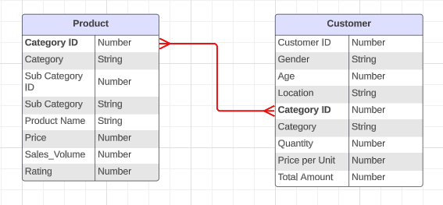
Entity Relationship Diagram (ERD)
M
M

Slide 6
Challenges Faced by TEMU
Shipping Delays
Inefficient Inventory Management
Customer Satisfaction Concerns

Slide 7
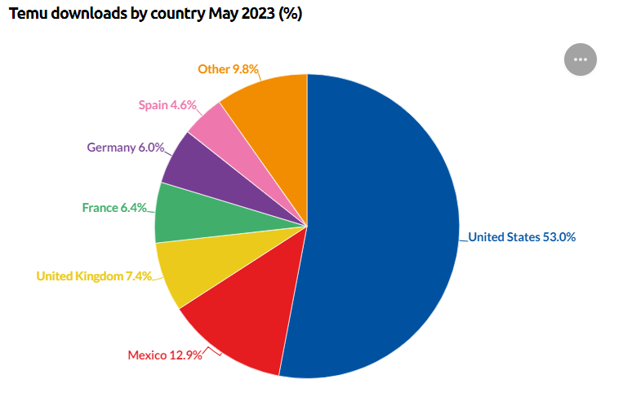
Temu Revenue and Usage Statistics (2023)

Slide 8
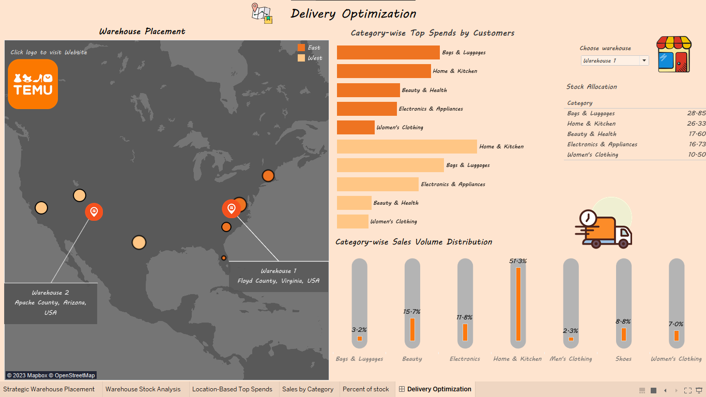
Dashboard

Slide 9
Conclusion
Strategically position warehouses in Virginia, Arizona for faster deliveries.
Prioritize stock allocation to meet high-demand categories, reducing delays.
Align supply with demand, minimizing delivery times for customer satisfaction.

Slide 10
THANK YOU

